Slide 1
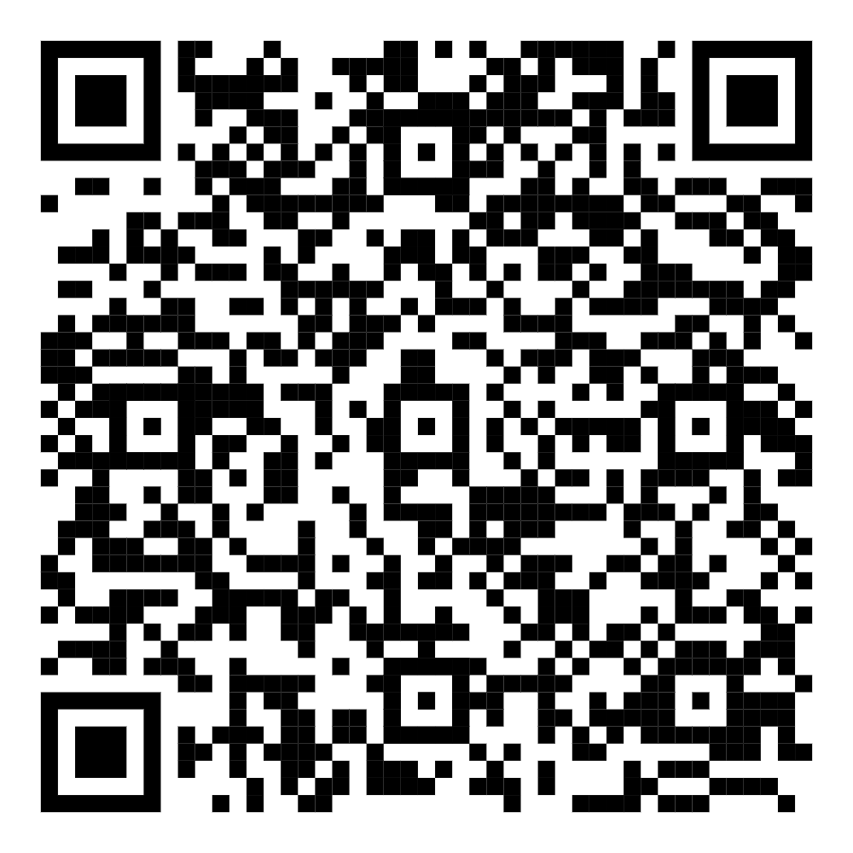
Midterm Debriefing Arrangements
To be held on Oct 31 (Thu) in class in your original classroom.
Students shall check only his/her own paper, NOT on behalf of others.
All answer scripts MUST be RETURNED to teacher/TA in the classroom.
If you HAVE ANY ENQUIRY about your paper or the grading:
Login https://cloud.itsc.cuhk.edu.hk/mycuform/view.php?id=2137789
Provide your personal particulars and pinpoint the relevant question(s).
Fill in the blanks and Submit.
Multiple submissions is accepted, say, you may add some new inputs/points.
Return your paper to the CHECK POOL. We will handle the matter in our office.
If you have NO PROBLEM:
You NEED NOT login the CU Webform.
Return your paper to the OK POOL.
You may start working Project.

